Slide 1
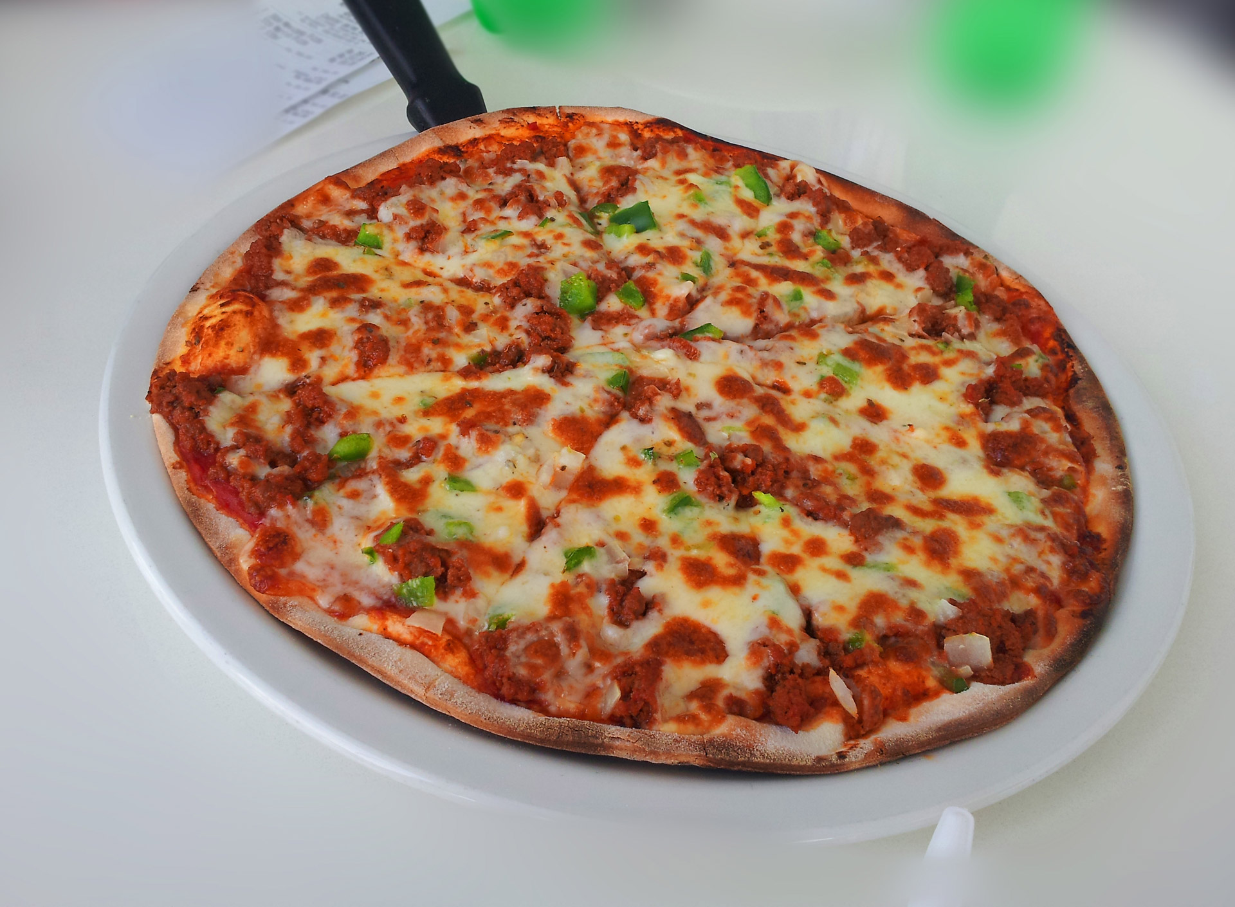
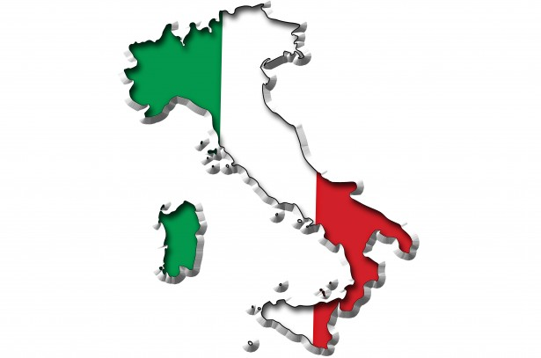


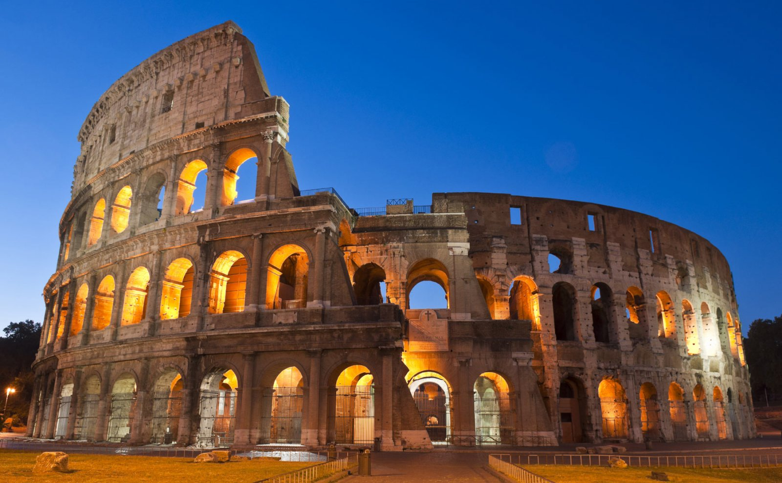
  Una lezione sulla
genealogica italiana
This Photo by Unknown Author is licensed under CC BY-SA-NC
This Photo by Unknown Author is licensed under CC BY-NC-ND
Notes:
Here is a good introduction to properly conducting genealogical and family history research:
https://youtube.com/watch?v=Rk2RVQBLrq4
All the slides in this presentation, with notes that include website addresses are available at
www.valledolmo-genealogy.org and clicking on “Beginning Italian Genealogy” in the left hand column

Slide 2





Vostri Antenati
Watch it!
Hey!
Ouch!
Let me out!

Slide 3
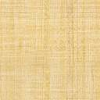
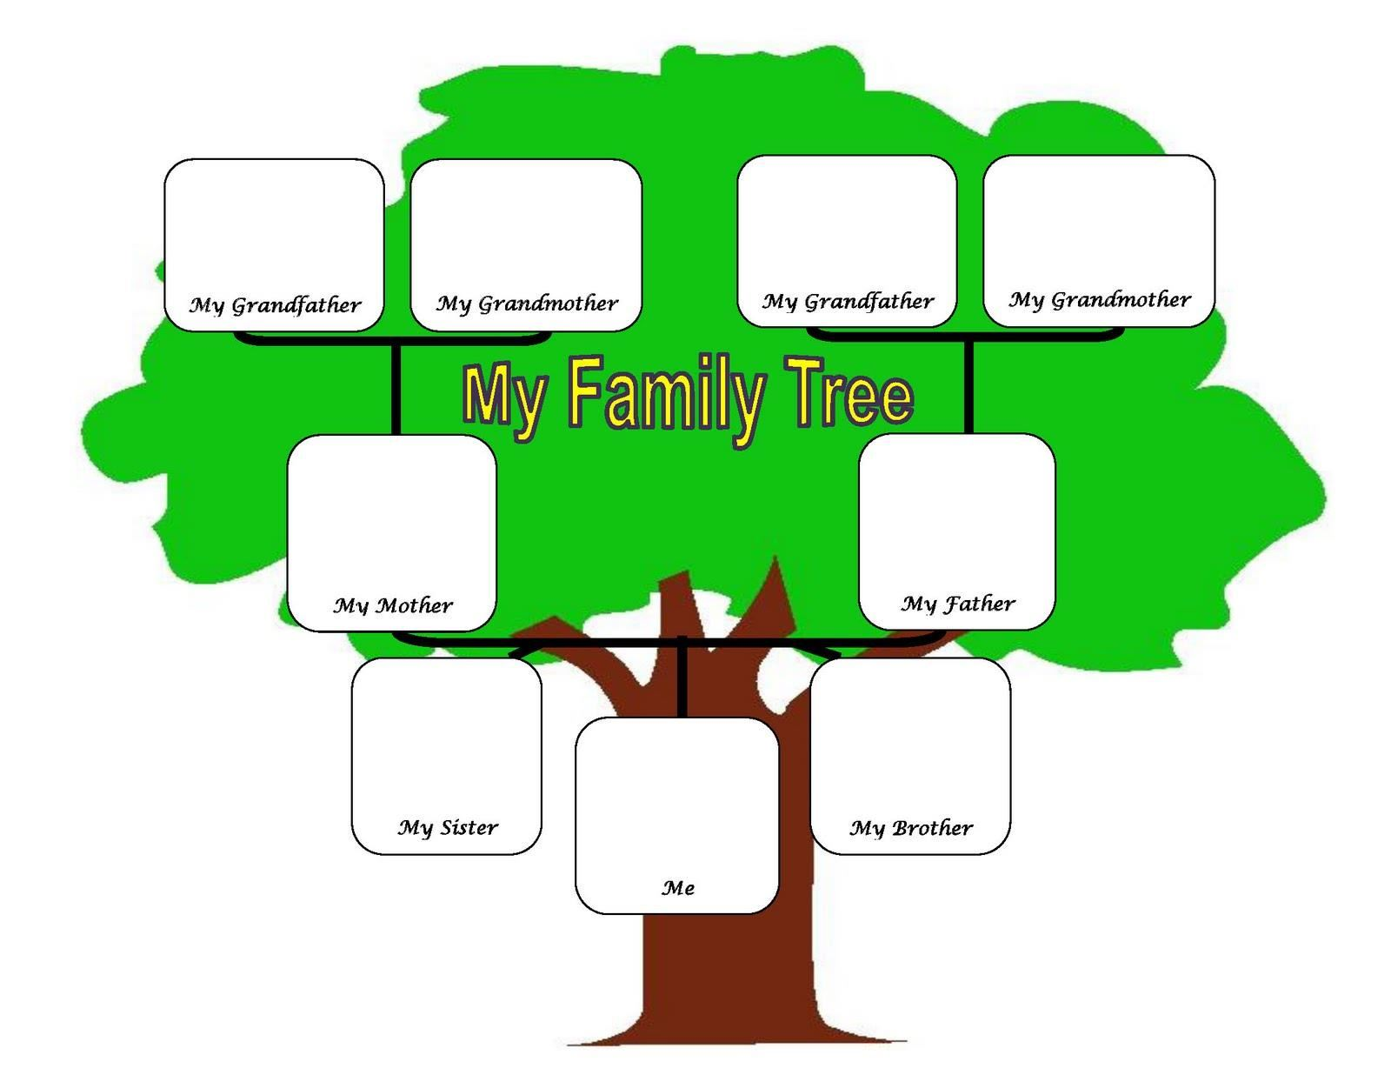
Notes:
Family Tree Builder is a free genealogical application that is available for both Windows and OS.
It is available for download at: myheritage.com

Slide 4
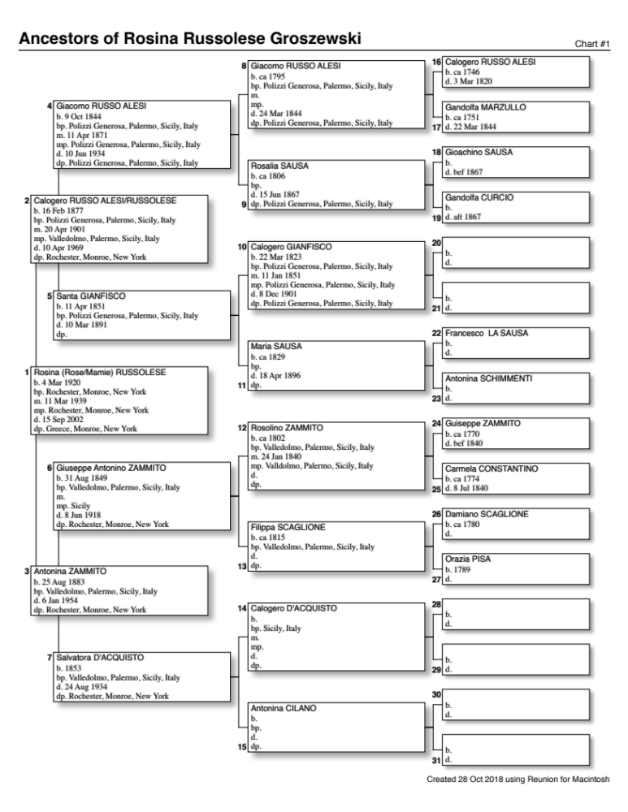
Cascading
Pedigree
Giacomo RUSSO ALESI
b. 9 Oct 1844
bp. Polizzi Generosa, Palermo, Sicily, Italy
m. 11 Apr 1871
mp. Polizzi Generosa, Palermo, Sicily, Italy
d. 10 June 1934
dp. Polizzi Generosa, Palermo, Sicily, Italy
Notes:
Pay attention to the order of terms in dates and places. The European form of dating is always used.

Slide 5
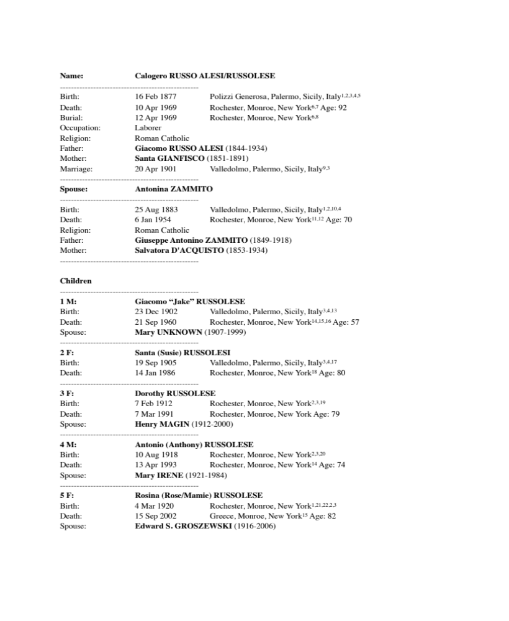
Family Group Sheet

Slide 6




Those persnickety citations
Notes:
Proper citing of sources is critical. No proper genealogist or family researcher would accept any project without complete references.
Fact + citation + (reasoning) = proof
If you use Family Tree Builder, and enter the source information on their forms, your citations will be acceptable.
If you choose to use another program, you can find more information by following this path: 1) Familysearch.com 2) Help (upper right corner) 3) Research Wiki from menu 4) use “citing sources” as search term 5)select “Cite your sources”

Slide 7
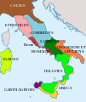
Where are (were) they?
Here?
But nonna said
I’ve got a letter from
Sicily?
Notes:
How to find a place of family origin, go to: Family Search 2) Learning Center 3) Enter “Italian Genealogy” in the search box 4) Italy Research with the Wiki, items 12,13,14
Or
Family Search 2) Research Wiki 3) Enter “Italy” in the search box 4) go to Locating Town of Origin in Italy

Slide 8

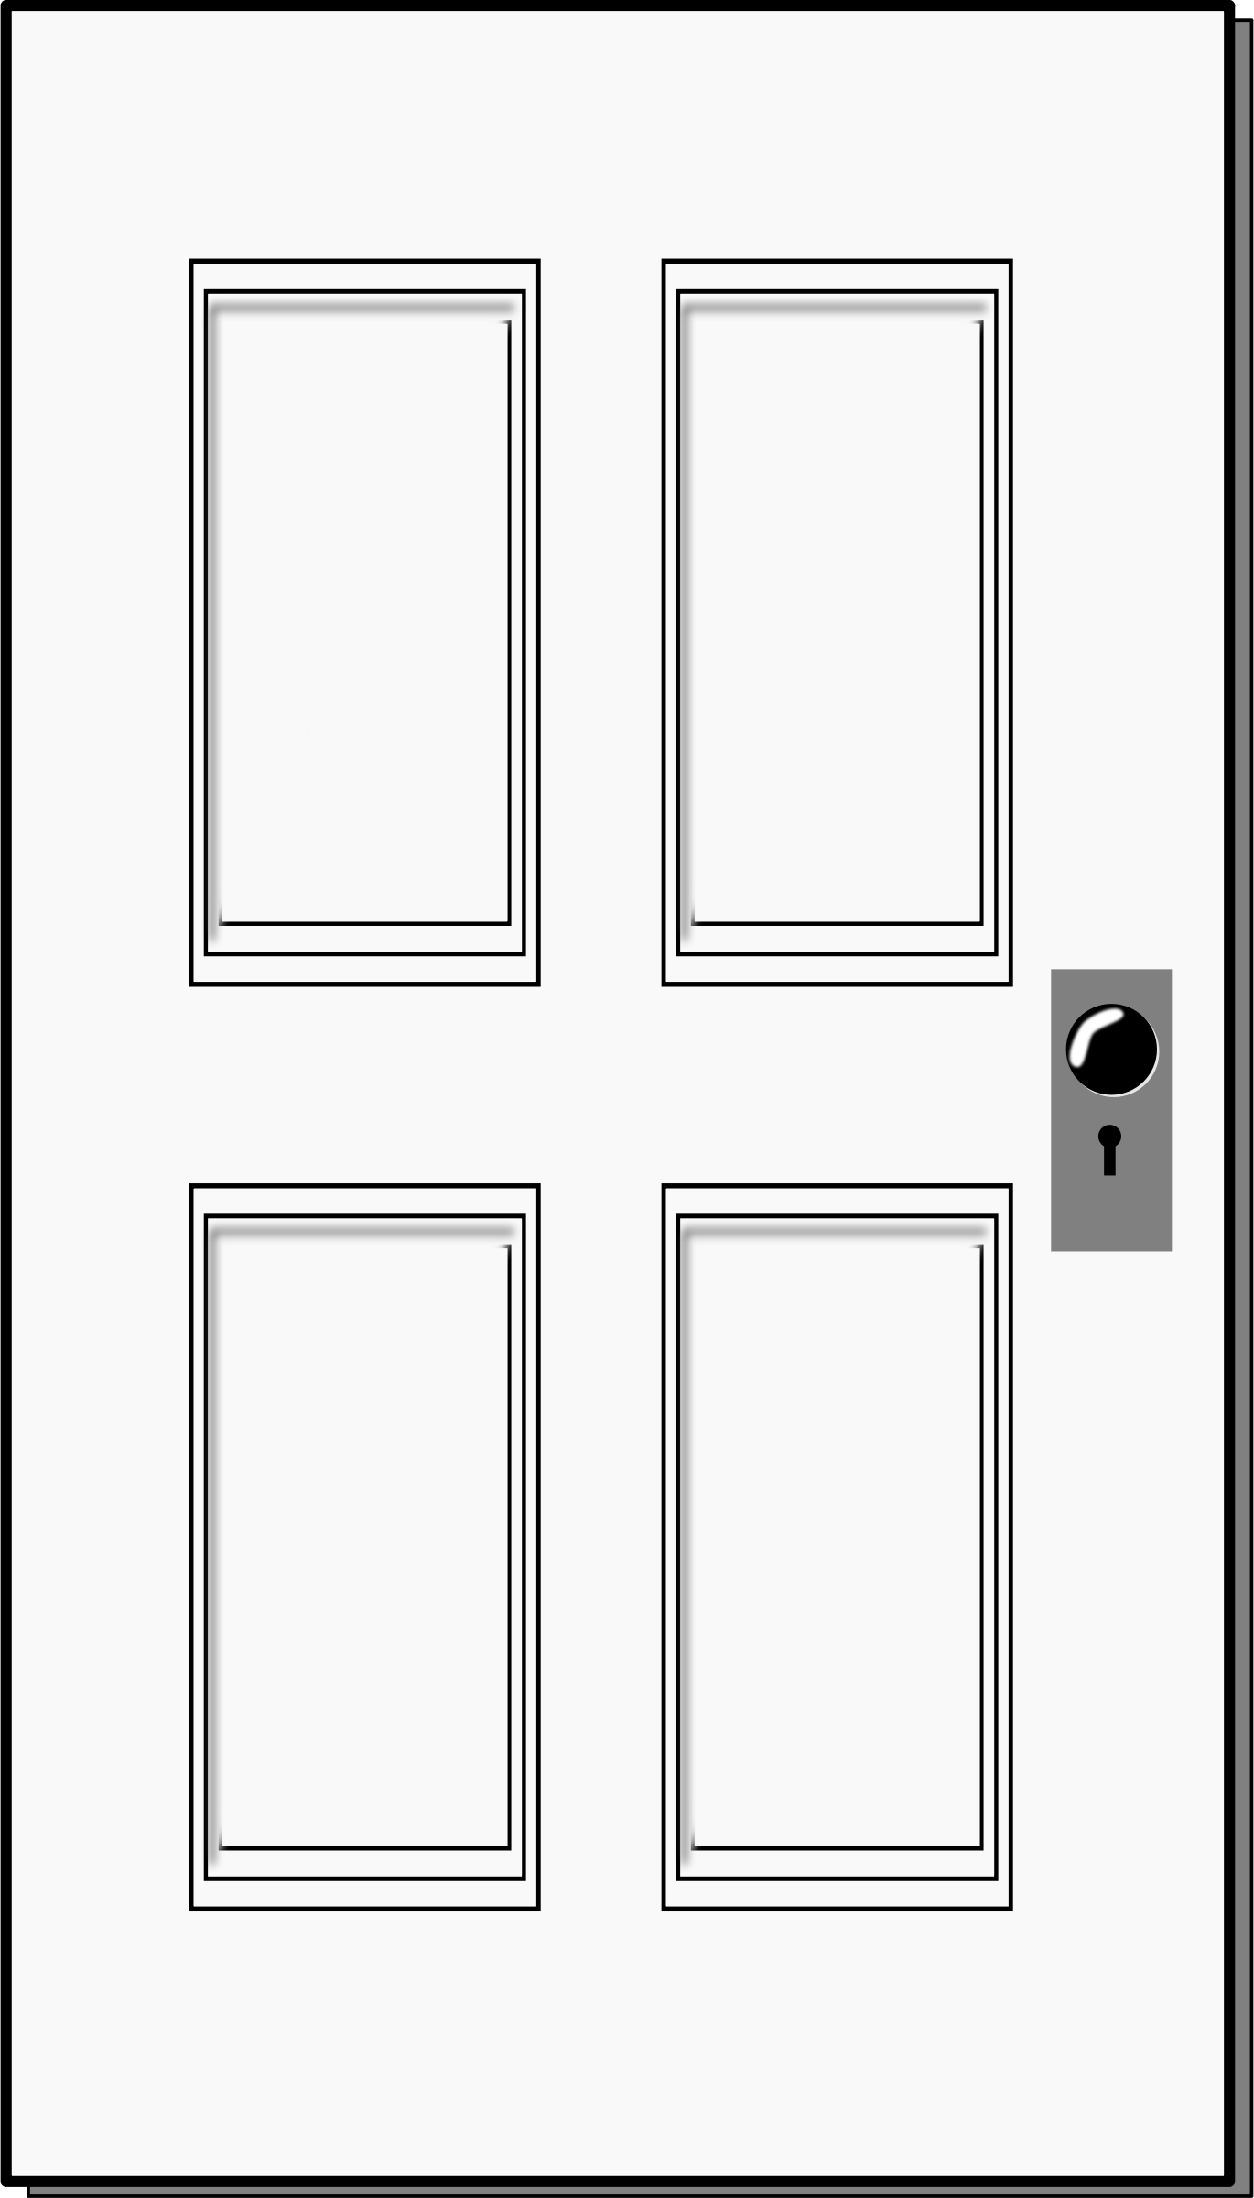
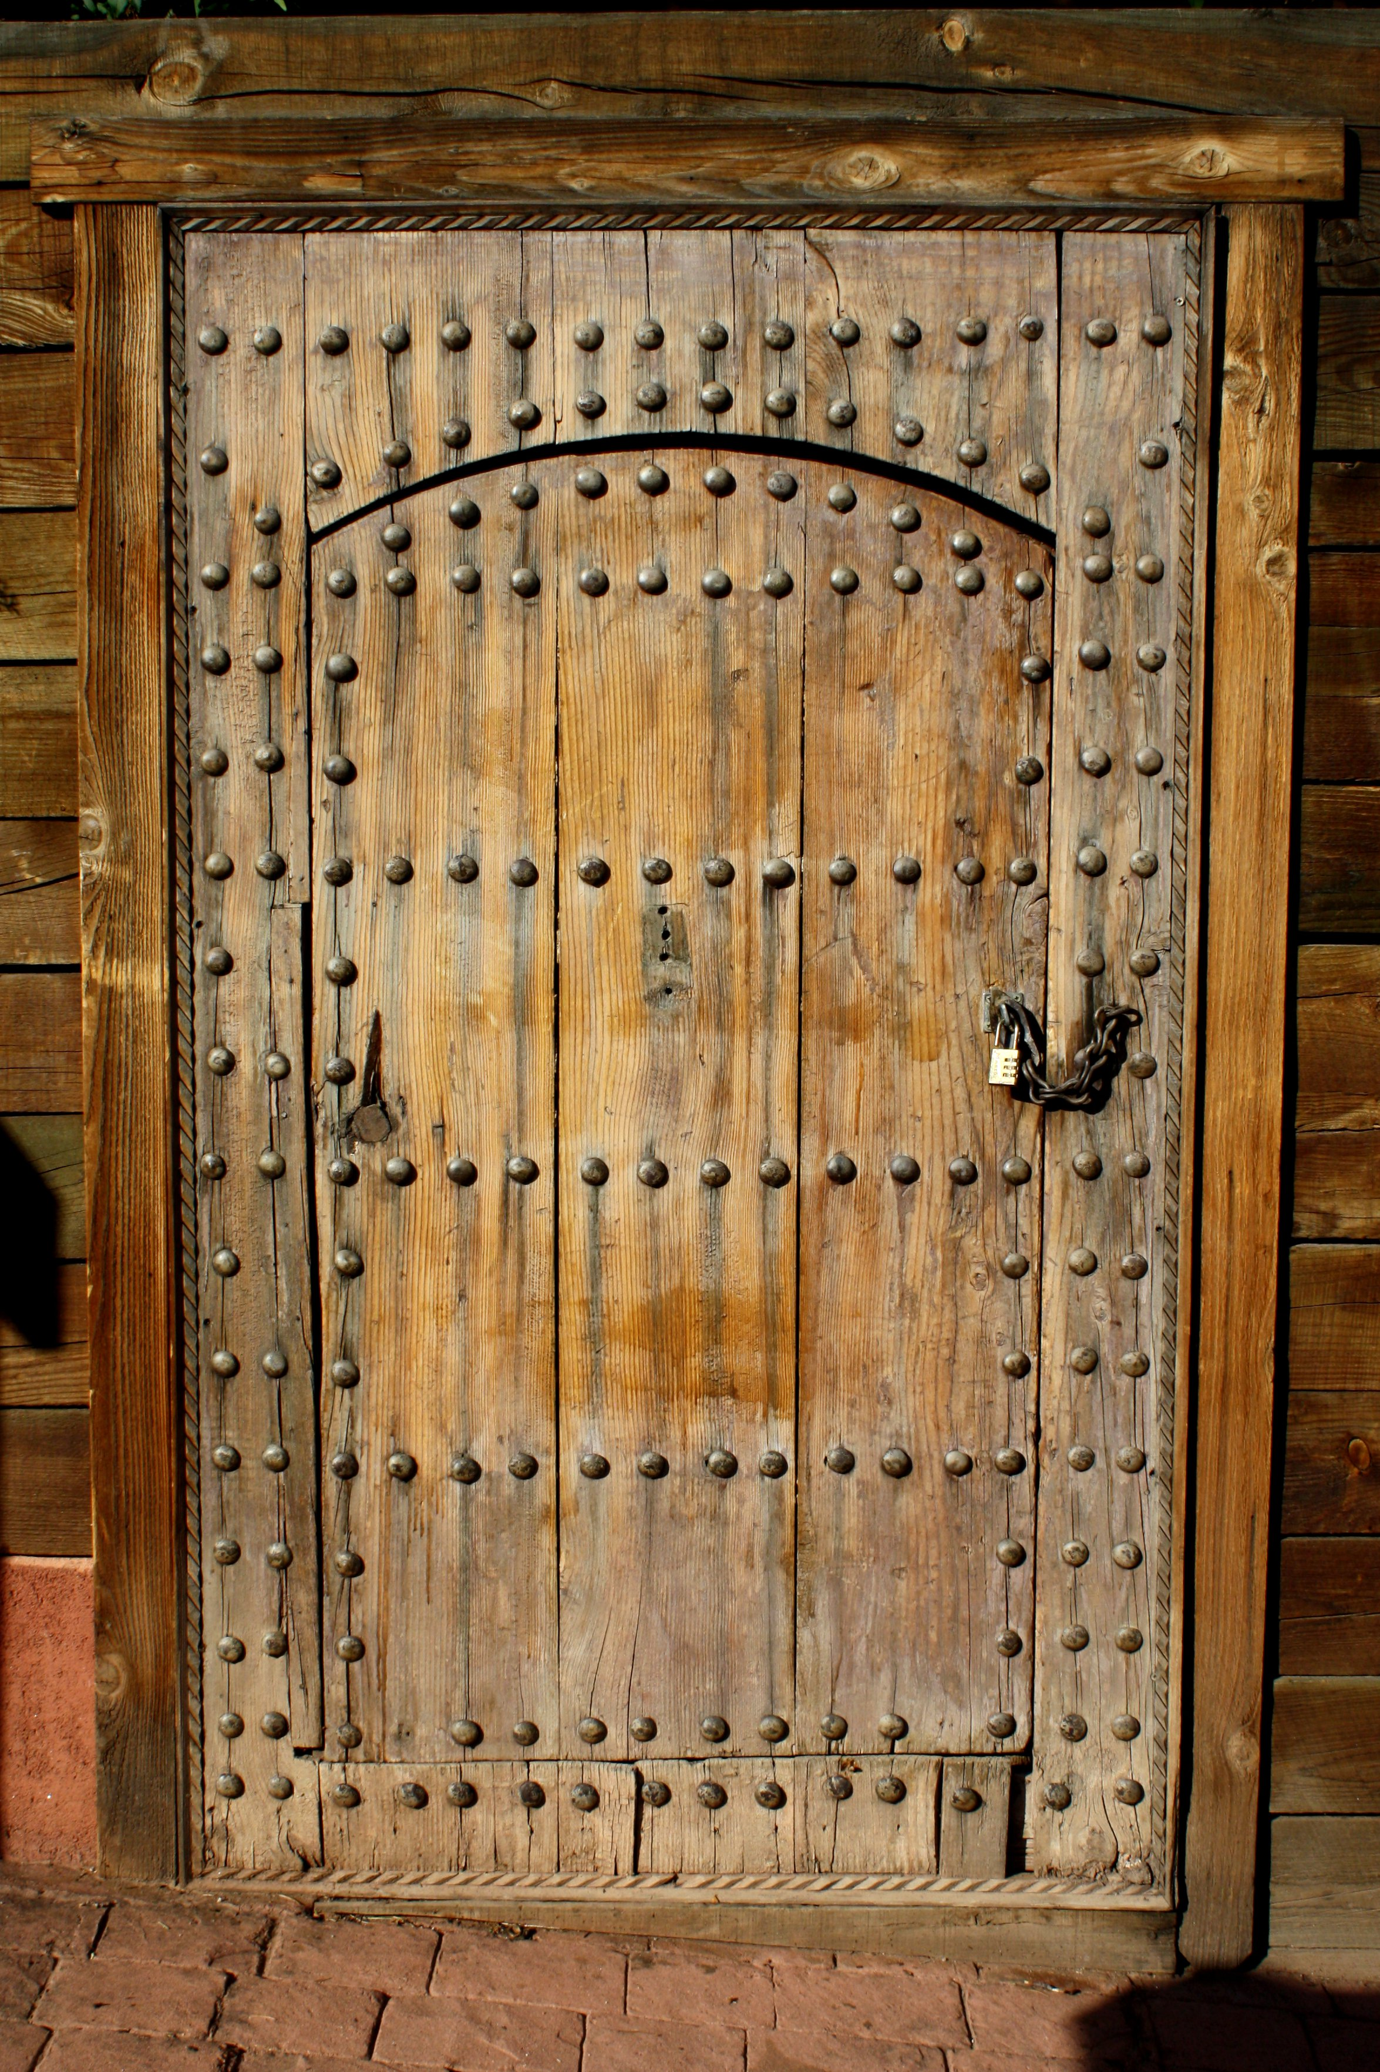
Where’s the good stuff?
Here?
Here?
Here?
Notes:
LDS Family History Center
1400 Westfall Road
Ph. 271-5040
Hours: Tue 9am to 3pm and 7pm to 9pm, Wednesday 9am to noon, Thurs 9 am to noon, Friday 9am to 3pm, Sat 9am to noon

Slide 9

Notes:
Website: www.Ancestry.com
It can be expensive, but it is free at most libraries and at the Family History Center
Search for your ancestor by name
And
Under the search menu look at each item separately, if you wish

Slide 10
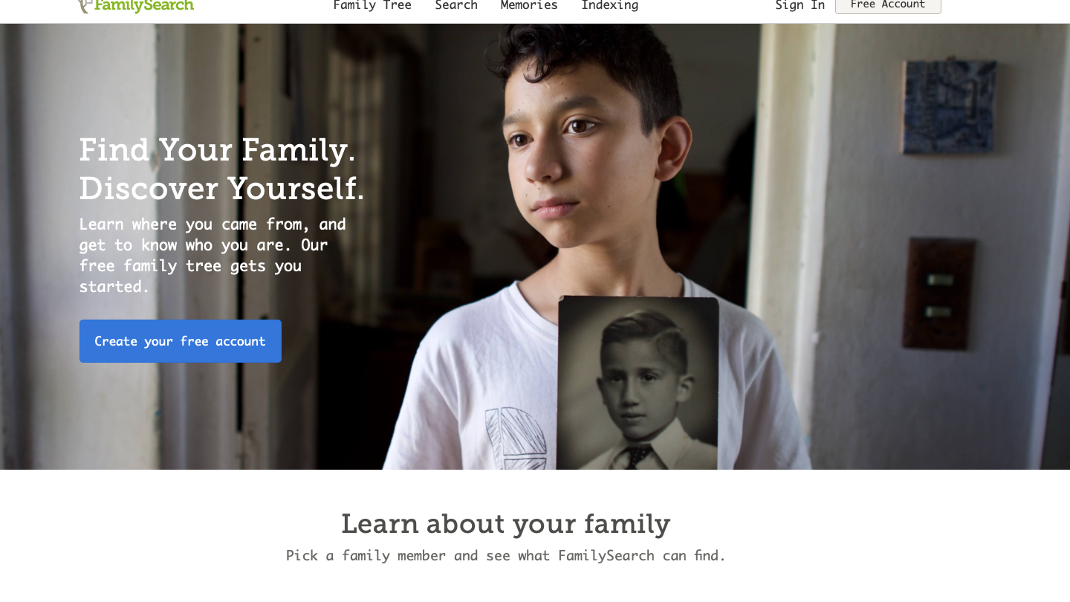
Family Search
Notes:
www.familysearch.org
Search Records
And
In the search menu, click on Catalog, enter the place in Italy you are looking for, go to civil registration line, scroll through the list of records
If in the right hand column, a camera with a key atop appears, the records are only available at a FHC, if only a camera appears the records are available from your home computer
click on ”Browse through”, select the village you want and then the type of record you want

Slide 11
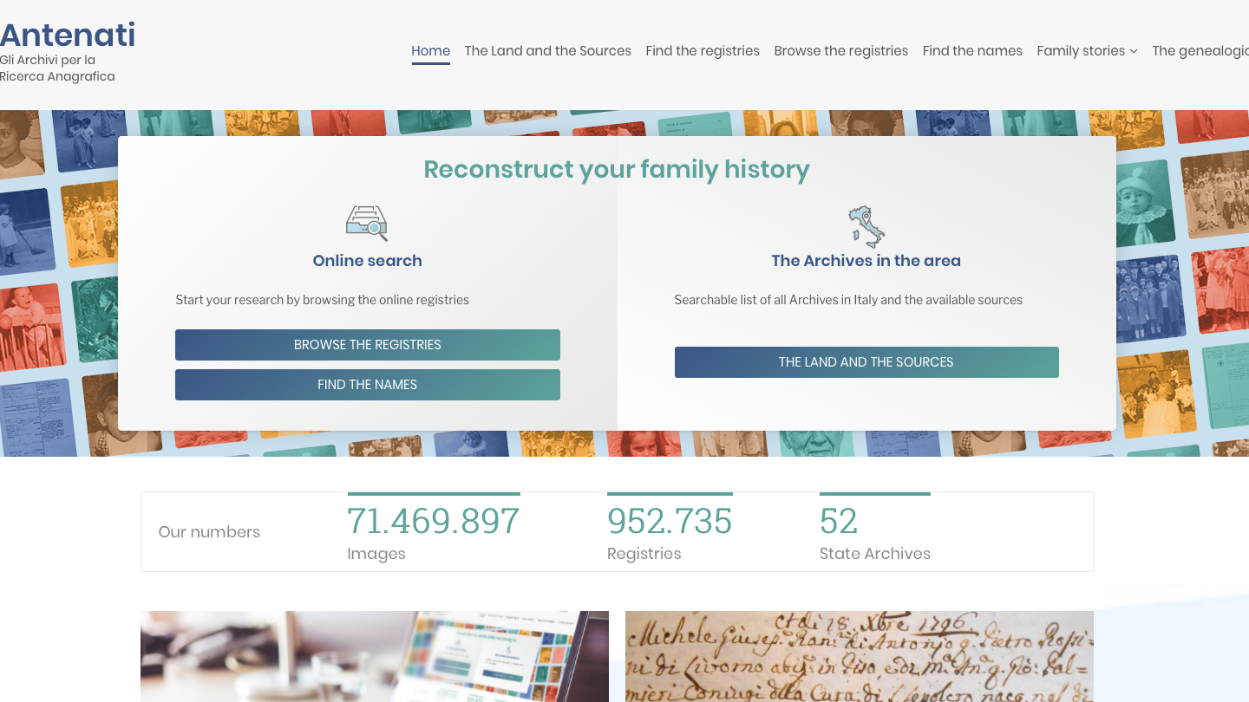
Antenati
Notes:
Address: http://www.antenati.san.beniculturali.it/?lang=en
To use: be sure the screen is in English
Click on Browse the Registries
Select the region you want to research
Click on “Stato civile della restaurazione”
Cllick on the Comune or villagio you are looking for (perhaps on a following screen)
Select the year and the type of record you are searching for
THIS SITE MAY BE VERY SLOW OR NON-RESPONSVIE AT TIMES. PATIENCE!

Slide 12
Other sources
Ellis Island records @ https://www.libertyellisfoundation.org
Steve Morse. Org
Fulton History @ http://fultonhistory.com
NYS Vital records index at the Main library
Rochester Historic Marriage Records (only within the city boundaries)

Slide 13

Reading the Records
Io lo ho trovato !
Che cose?
Buono Lavoro!!

Slide 14
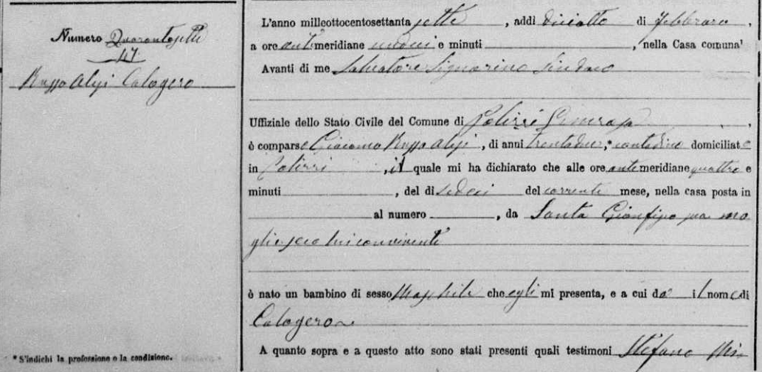
Atti di Nascita
Records of Births
Date of recording
Recorder’s name
Father’s name
Date of birth
Mother’s name
Sex of child
Child’s name

Slide 15
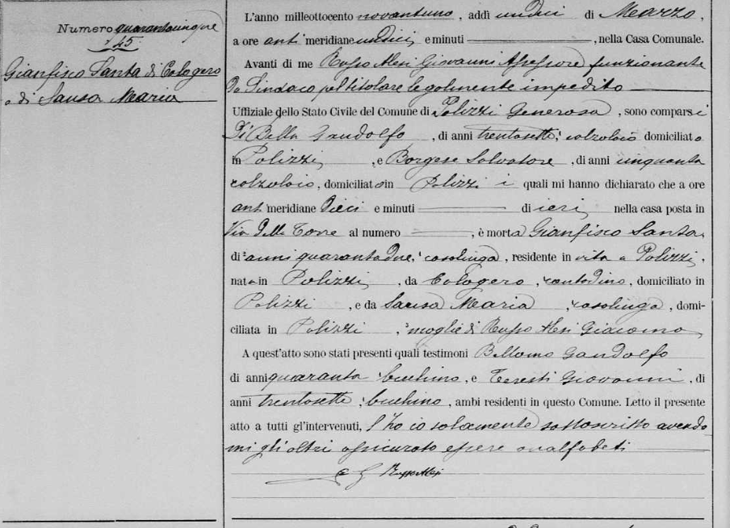
Atti di Morti
Records of Death
Name of recorder
Names of reporters
Date
Name of decendent
Age of decedent
Name of decedent’s father
Name of decedent’s mother
Name of Spouse

Slide 16
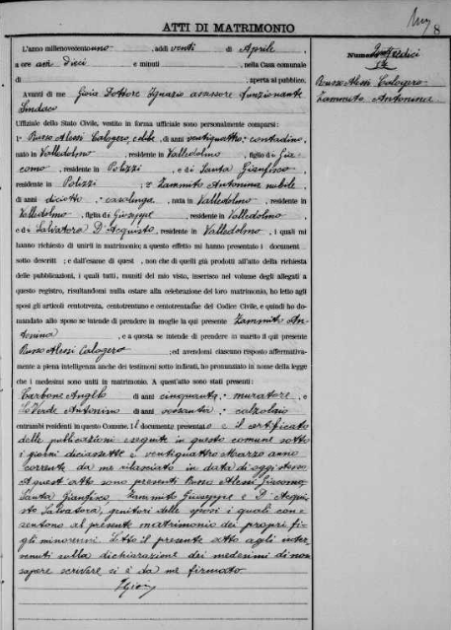
Atti di Matrimonio
Records of Marriage
Date of the wedding
Name of Recorder
Name, age, and occupation of groom
Parents of groom
Name, age, marital status, and occupation of bride
Parents of bride

Slide 17

Aiutami!
How to get help
This Photo by Unknown Author is licensed under CC BY-SA
Notes:
FamilySearch website
FamilySearch.org
Italian Records
or
Research Wiki , Enter Italian in Search Box
Cyndi’s List
Italian Genealogical Records, by Trafford Cole

Slide 18
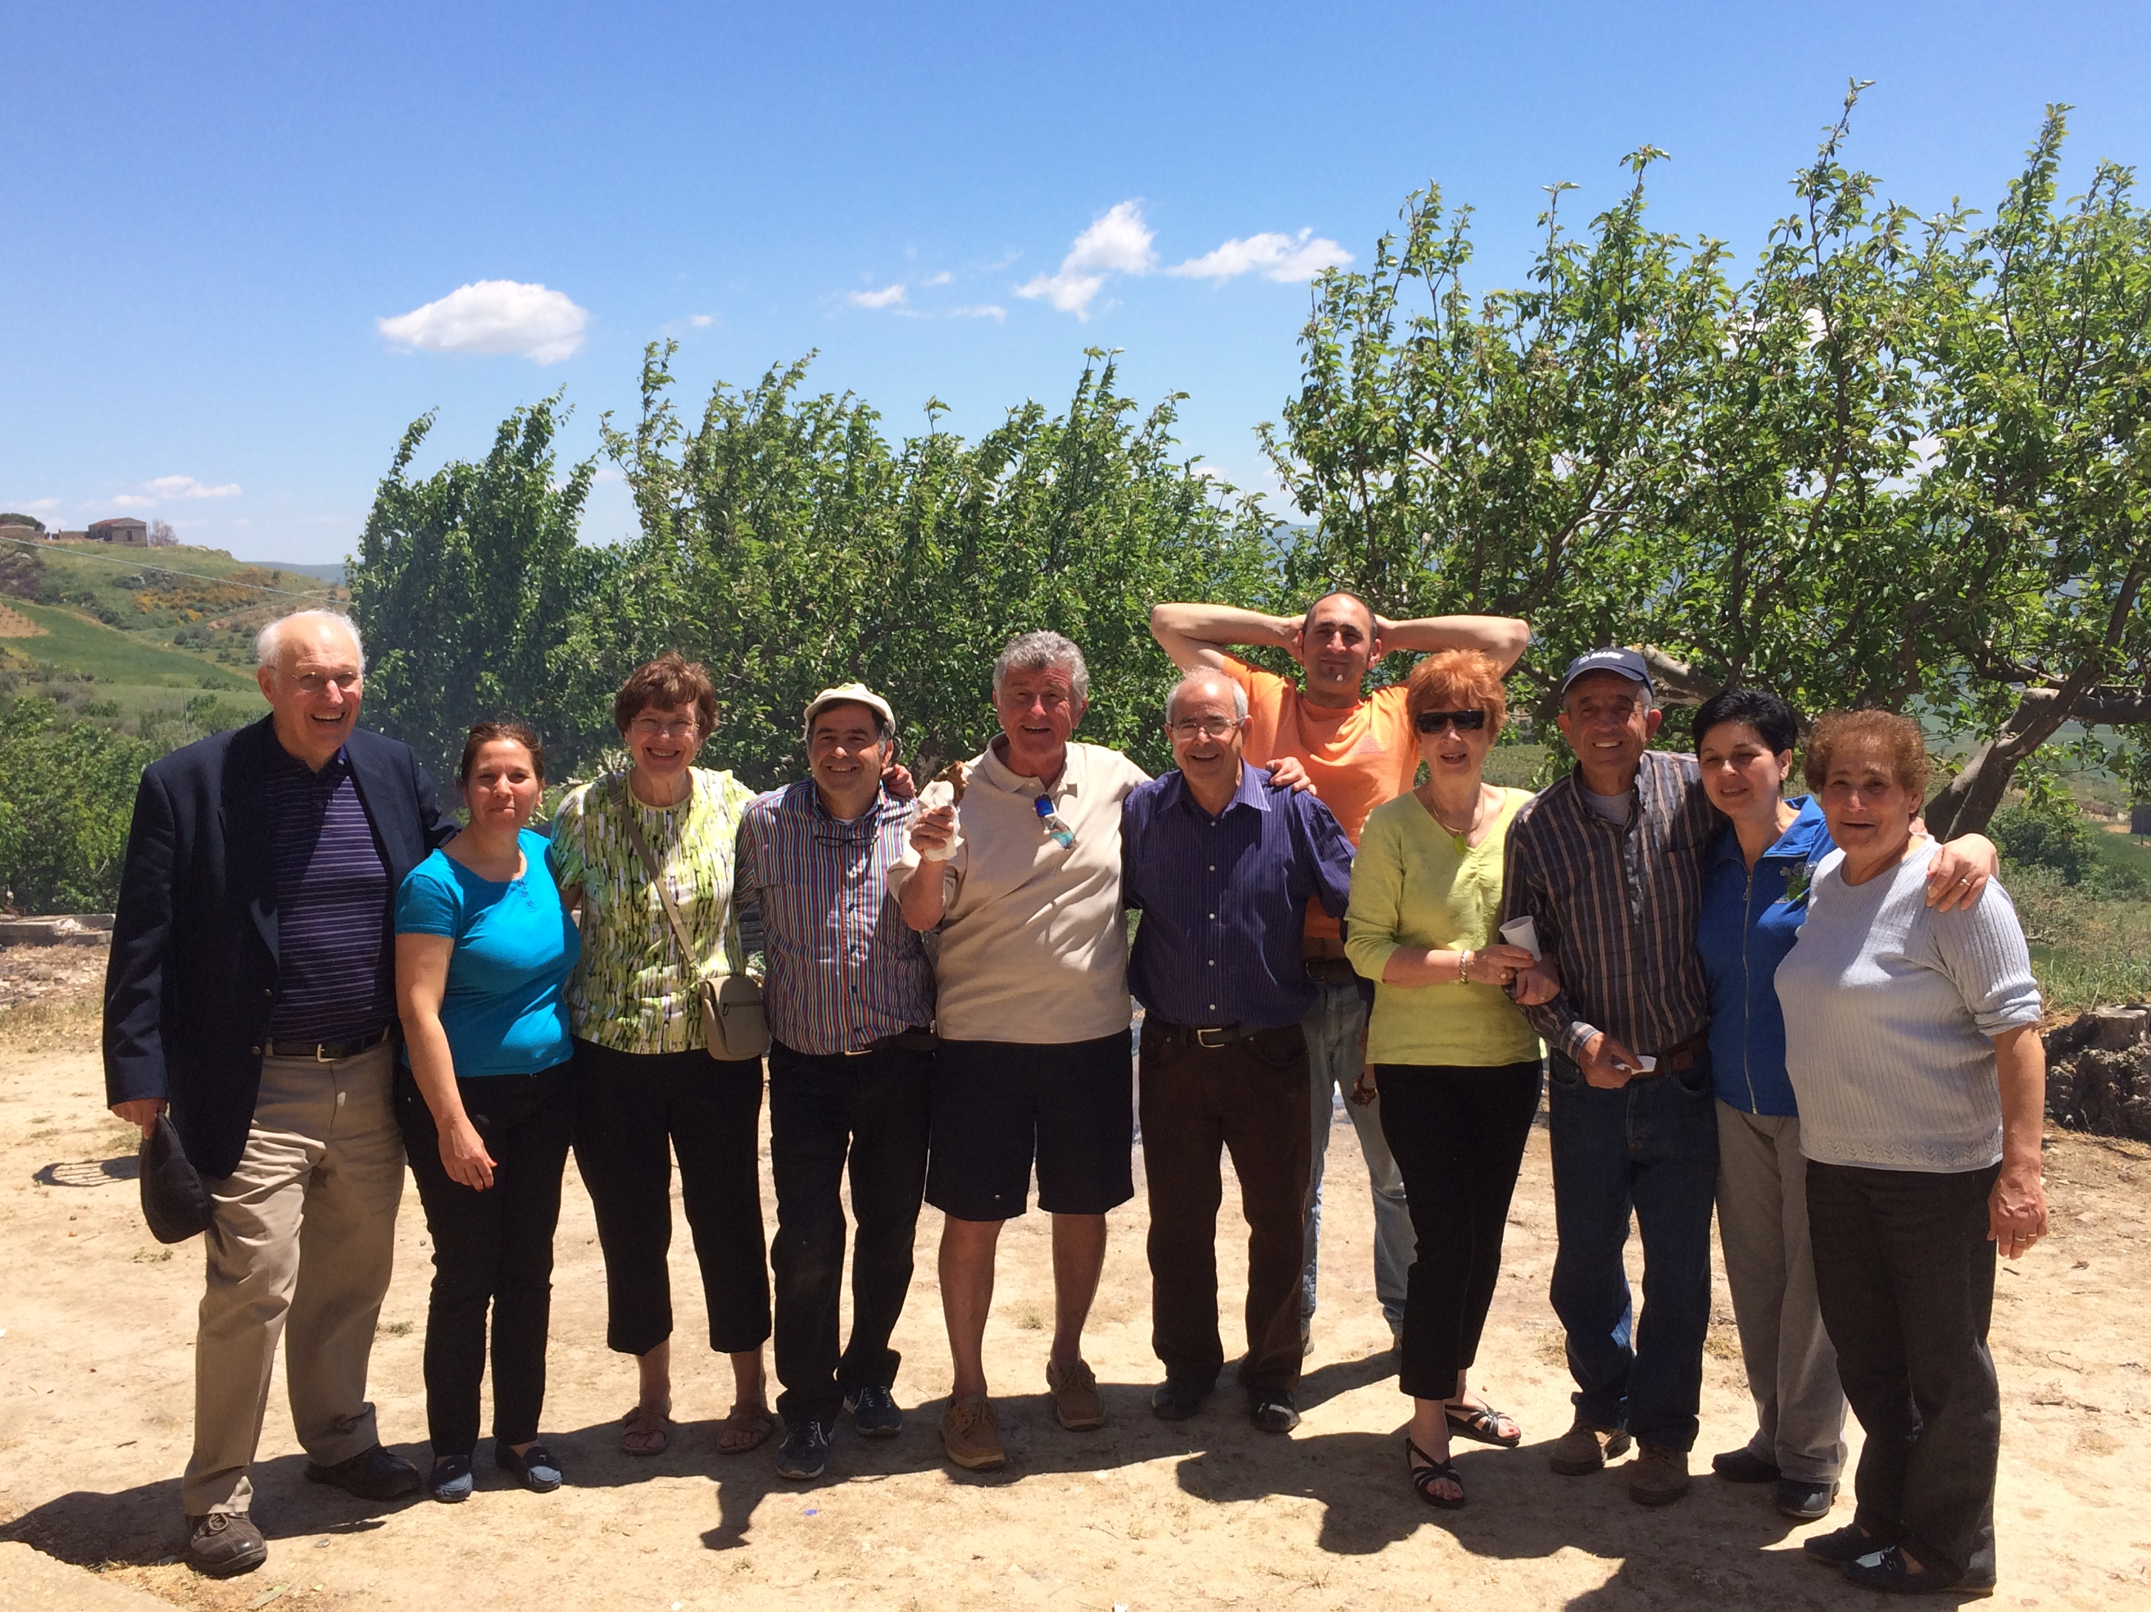
Isola bella, famiglia bella

